Slide 1
ELEMENTS OF PROGRAMMING CSC 1100 Semester 1, 2017/18
LECTURE 0 :
AN INTRODUCTION
Mdm Suriani Sulaiman
Office: Level 5, KICT
Email : ssuriani@iium.edu.my
Ext : 5459
4
4
C5.31

Slide 2
Course Synopsis
This course has been designed to introduce students to the fundamentals of structured programming using C++. Students will have the opportunity to learn about C++ program structure, how to create and use functions, arrays, pointers and records in C++ programs, how to manipulate and use selection and repetition statements/controls and finally on how to import and export an input/output file.

Slide 3
Learning Outcome
At the end of the course, students are expected to be able to :
demonstrate the familiarity with structured programming technique
apply algorithm for problem solving following structured programming principles and practices
develop small-scale applications using structured programming language
participate effectively in group work to construct structured-based applications
apply the Islamic ethical and professional responsibilities in developing applications

Slide 4
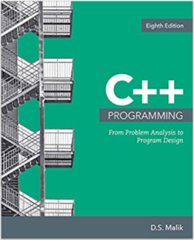
References
Required Text:
Malik, D. S. (2018). C++ Programming: From problem analysis to program design. (8th ed.). United States: Cengage Learning.

Slide 5
References
Recommended Text:
Bronson, G. J. (2012), A First Book of C++, Fourth Edition. United States: Cengage Learning
Malik, D. S. (2015). C++ Programming: Program Design Including Data Structures. (7th ed.). United States: Cengage Learning.
Deitel, H. M., & Deitel, P. J. (2013). C++ how to program (9th ed.). United States: Prentice Hall.
Friedman, F. L., & Koffman, E. B. (2010). Problem solving, abstraction, and design using C++ (6th ed.). England: Addison Wesley.
Horstmann, Cay. (2012). C++ for Everyone (2nd ed.). United States: John Wiley & Sons.
Stroustrup, B. (2014). Programming: Principles and Practice Using C++ (2nd ed.). United States: Addison-Wesley.
Stroustrup, B. (2013). The C++ Programming Language (4th ed.). United States: Addison-Wesley.

Slide 6
Software Required
Dev C++ Version 5.11 (TDM GCC 4.9.2 SETUP.EXE)
https://sourceforge.net/projects/orwelldevcpp/
Code::Blocks(codeblocks-16.01-setup.exe)
http://www.codeblocks.org/downloads/26

Slide 7
Course Assessment
Quizzes (3 x 5% each) 15%
Individual
Online
Group
Assignments (3 x 5% each) 15%
Individual
Pair
Group
Lab Test (2 x 7.5% each) 15%
Group Project 15%
Lab Practical (In-class +Tutorial) 10%
Final Assessment 30%
*Tutorial Session : EVERY THURSDAY(5 – 6.50 pm): Starts #Week3

Slide 8
Attendance
At least 85% (max. of 3 classes missing)
1 class missed ~ 3-5% penalty
Between 1-3 classes missed --> Warning letter
A copy will be sent to parents/sponsor
More than 3 classes missed --> Barring letter
Students are not allowed to take the Final Assessment
Valid medical certificate(IIUM Health Center) is needed for excused absence due to sickness
Other emergency cases needs valid letter from authorised parties
Attendance to tutorials are compulsory
Same rules apply

Slide 9
CSC 1100 Schedule for Semester 1 2017/18
# Week 1 – 7 (T-TH)
Wk # | Start Date | Lecture/Tutorial | Remarks
1 | 12/9/2017 | Ch. 1: Overview of Computers & Programming Languages
 | 14/9/2017
2 | 19/9/2017 | Ch. 2: Basic Elements of C++: Data Types, Declarations and Assignments
 | 21/9/2017
3 | 26/9/2017 | Ch. 3: Input/Output I: Interactive Input & Output Displays
 | 28/9/2017 |  | QUIZ 1 (Ch 1 - 3)
4 | 03/10/2017 | Ch. 4: Control Structures I: Selection
 | 05/10/2017 |  | PROJECT ASSIGNMENT
5 | 10/11/2017 | Ch. 5: Control Structures II: Repetition | ASSIGN 1 (Ch 1 - 5)
 | 12/11/2017 |  | QUIZ 2 (Ch 4 – 5)
 | 17/10/2017 | MID SEMESTER BREAK
 | 19/10/2017
6 | 24/10/2017 | Ch. 6: Modularity using Functions | ASSIGN 1 DUE
 | 26/10/2017 |  | IOW (Blackout Week)
7 | 31/10/2017 | Ch. 6: Modularity using Functions
 | 02/11/2017 | LAB TEST I | Ch 1 – 6

Slide 10
CSC 1100 Schedule for Semester 1 2017/18
# Week 8 – 14 (T-TH)
Wk # | Start Date | Lecture/Tutorial | Remarks
8 | 7/11/2017 | Ch. 8: Arrays
 | 9/11/2017 |  | ASSIGN 2 (Ch 6,8)
9 | 14/11/2017 | Ch. 12: Pointers
 | 16/11/2017
10 | 21/11/2017 | Ch. 12: Pointers | QUIZ 3 (CH 8,9,12)
 | 23/11/2017 | Ch. 9: Structures & Records | ASSIGN 2 DUE
11 | 28/11/2017 | Ch. 9: Structures & Records
 | 30/11/2017 | Ch 3: Input/Ouput II: Data Files | ASSIGN 3 (Ch 9,12 & CH 3 PT II)
12 | 05/12/2017 | Ch 3: Input/Ouput II: Data Files
 | 07/12/2017 | LAB TEST II | Ch 8,9,12
13 | 12/12/2017 | Ch 10: Introduction to Object Oriented Concepts: Classes & Data Abstraction | ASSIGN 3 DUE
 | 14/12/2017 |  | IOW (Blackout Week)
14 | 19/12/2017 | PROJECT PRESENTATION | GROUP 1
 | 21/12/2017 |  | GROUP 2
15 | 23 - 27/12/2017 | REVISION WEEK | Project Report Due (24 Dec 2017) FINAL: CH 6-12, Ch 3 PT II

Slide 11
Consultation Hours
TUESDAY : 2.00 pm – 3.00 pm
WEDNESDAY : 3.00 pm – 4.00 pm
~ OTHERS: BY APPOINTMENT ONLY ~

Slide 12
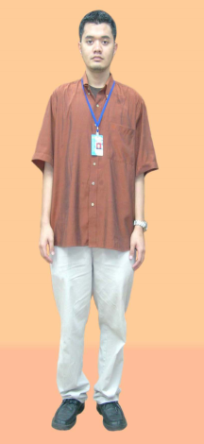
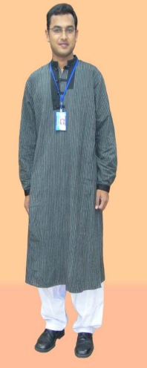
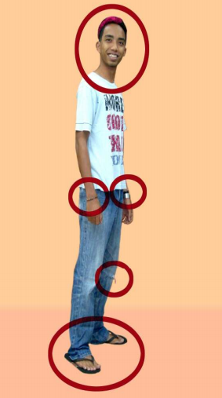
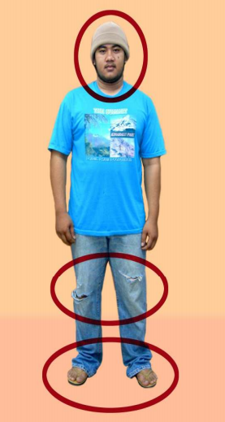




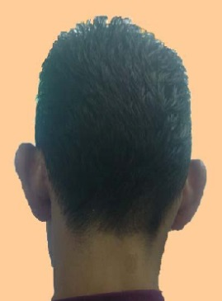

Dress Code (Male)
http://www.iium.edu.my/legaladviser/articles-4

Slide 13
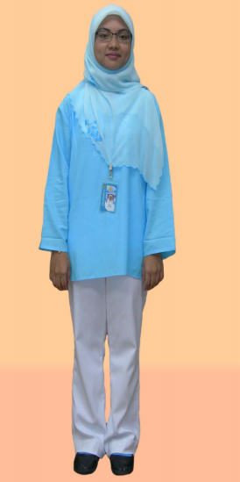
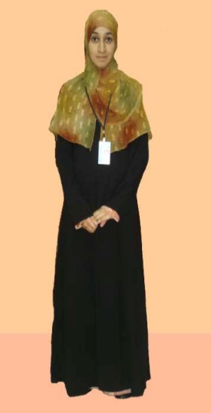


Dress Code (Female)
http://www.iium.edu.my/legaladviser/articles-4

Slide 14
Codes of Ethics
Cheating & Plagiarism
Any student caught for cheating or plagiarism will be penalized ( ‘0’ mark or reduced percentage )
However, working together in pairs/group is encouraged as long as the final solution is different
Cheating & plagiarism are unethical, you may get away with it in this class, but “ALLAH IS WATCHING …” ☺
Late Submission of assignments/project reports
Each student is given a 3 days “grace period” to submit either one of your assignments or project.
Each “grace period” must be used all at once (3 days consecutively) , used only once by each student and cannot be combined with others.
After this period, 5% of total marks will be deducted from your assignment/project for each day of late submission.

Slide 15
Course Materials
All course materials are accessible through iTaleem (Innovative Teaching and Learning Environment System).
Can be accessed at:
https://italeem.iium.edu.my/2017/login/index.php
Submission of quizzes, assignments and projects will be done through iTaleem.

Slide 16
iTaleem
https://italeem.iium.edu.my/2017/
Login with user id and password (matric & password).

